Slide 1
Cut Scores

Slide 2
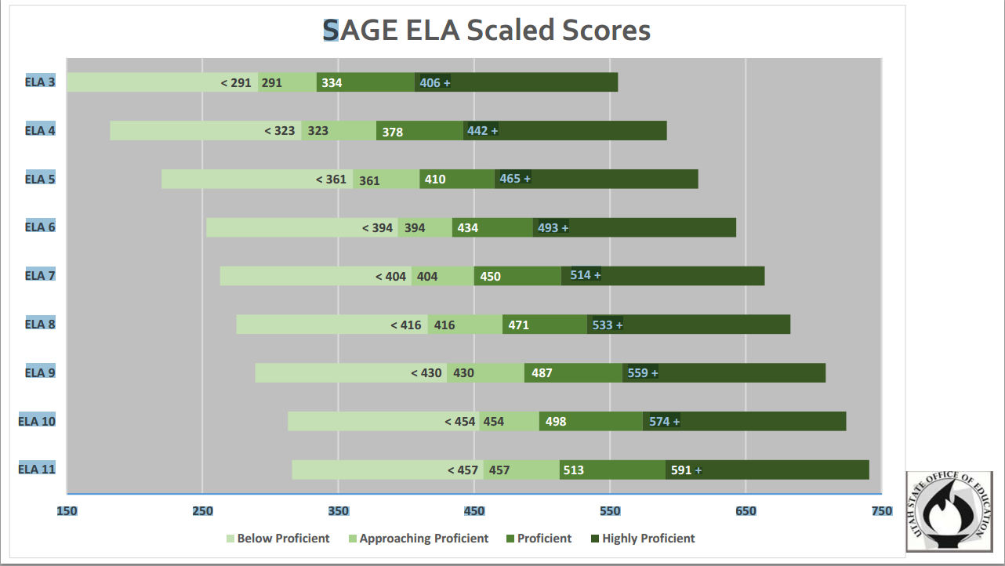

Slide 3
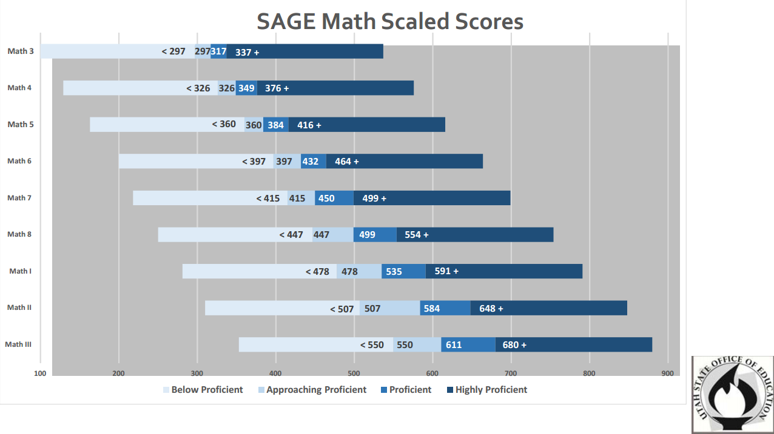

Slide 4
