Slide 1
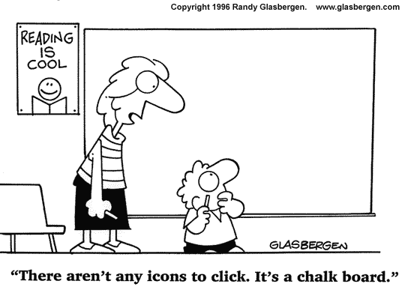
HS Staff Call
4.17.15

Slide 2
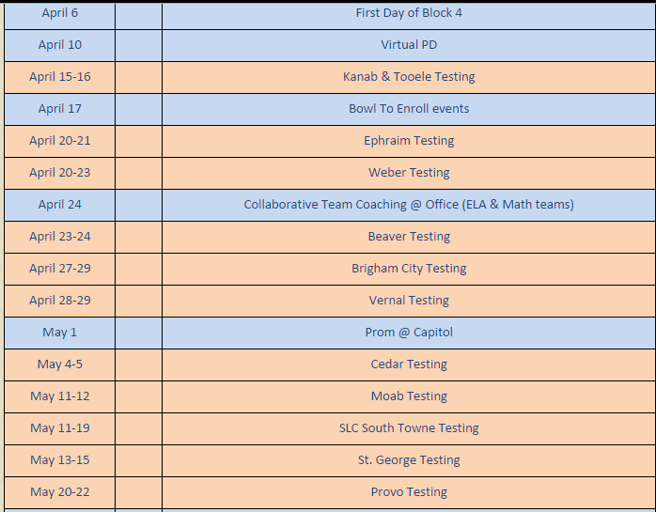

Slide 3

http://safeshare.tv/w/dbnLsfYdEE

Slide 4
Habit #4 - Think Win-Win
In a Win-Win relationship, both people are happy and feel equal.
Each person needs to develop a healthy definition of the word COMPETITION; develop a balance between wanting to win and doing it in a healthy, positive way.
Realize that COMPARISONS to other people are not healthy and a waste of your time
To have a winning relationship with someone, friendly competition can stay but comparisons must go.

Slide 5
What is a Win-win teacher/student relationship?

Slide 6

Reregistration Plan: Mass Messaging ---→ HR individual calls
K-8 Instructional Audit Findings
New policy for Ops troubleshooting template. Ask Meghan and she will send. Also will be posted on quick links.
Prom Details: Save the date and grab a date! May 1st 7-10 pm at the Capitol
Report Cards will be sent today.

Slide 7


Slide 8
Draw the Map
Teach Like a Champion
Technique 11

Slide 9

The virtual equivalent of moving the desks and deciding how students will interact with you, each other, and the lesson.

Slide 10
Draw the Map: Effective Planning
1
2
Virtual Environment
Interacting in the Environment
Physical Environment
3
Notes:
This is another option for an Overview slide.

Slide 11
The Last Step In Effective Planning
How do you set up your space?
  Physical
    Mic Check? Webcam Preview? Notes on laptop if you need a lesson reminder?
  Virtual
    What permissions do students need?
    Which permissions can they use to interact with the lesson?
    Break out rooms prepped?

Slide 12
Working Toward Mastery
Awesome Class
Make the Map
Successful Lessons
Draw the Map
Time Spent Planning

Slide 13

It’s 4th block—what now?

Slide 14

What is your role to play in
?

Slide 15
Name | What works?—what is the ONE thing I’m going to focus on this week?

