Slide 1
Finalizing UTVA HS
Block 4 Grades

Slide 2
Before Finalizing Grades
1. Lock down all assignments. You can do this by using the Course Scheduler under Course Admin
2. Grade and return all teacher graded items.
3. Where needed, enter zeroes for all incomplete/ missing work. All sections must have a numeric or alpha character
4. Enter any extra credit.
5. Call students and resolve any missing final exams.

Slide 3
Steps in the Process
1. Enter letter grades in LMS grade books.
2. Export grade books in Show All view.
3. Compile everything into one workbook with separate tabs for each of your classes. Saving directions to follow in this presentation.
4. Upload to the shared dropbox. Deadline is 6/8/2015 5:00.

Slide 5
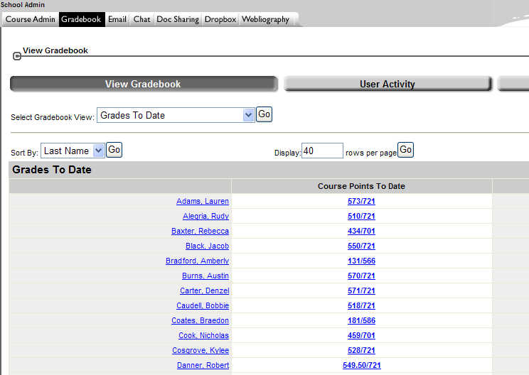
Enter Letter Grades
Enter your gradebook.
Student names will appear here.

Slide 6
Enter Letter Grades
In the Grades to Date view click the first numeric score.
Student names will appear here.

Slide 7
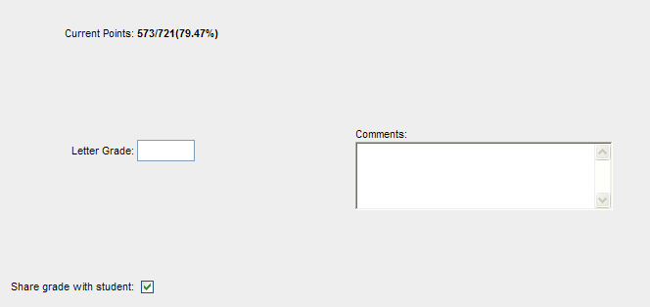
Enter Letter Grades
In the screen that opens, type the letter grade that the student has earned in your class. Make sure to “share grade with student.”
DO NOT ISSUE A+ or I
B
Make sure this box is checked also.

Slide 8
Enter Letter Grades
Click Save & Next.

Slide 9
Enter Letter Grades
Continue in this manner until you reach the last student. Then click Save & Close.

Slide 10
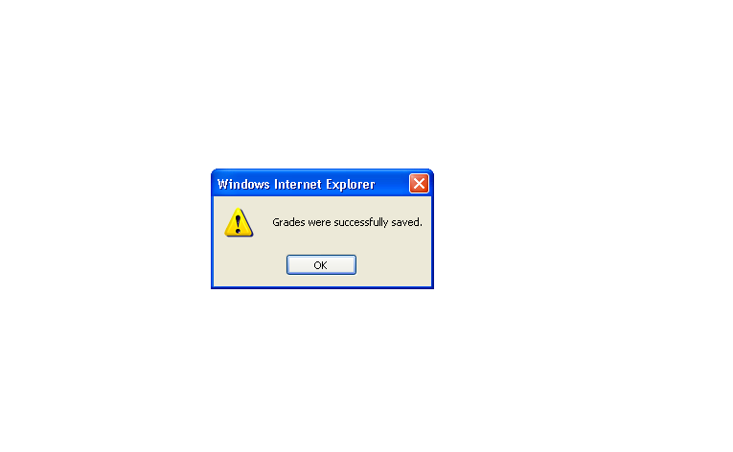
Enter Letter Grades
Click OK.

Slide 11
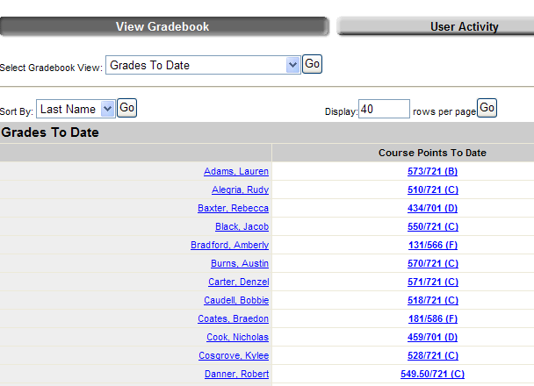
Enter Letter Grades
You will then be brought back to the Grades to Date screen where you should now see the letter grades next to each score. Repeat this process for each of your classes.
Student names will appear here.

Slide 12
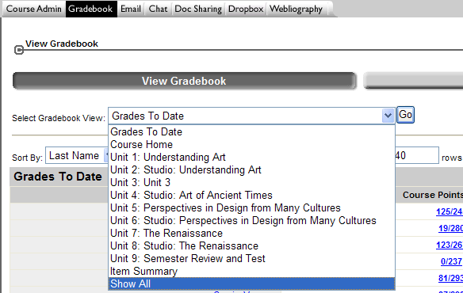
Export Grades
Click the dropdown arrow next to “Select Gradebook View:”, choose Show All and click Go.
1. Click the dropdown arrow.
3. Click Go.
2. Choose Show All.

Slide 13
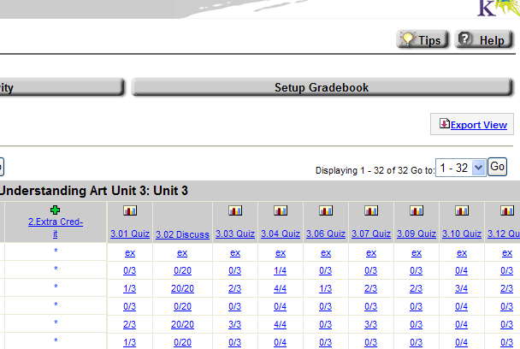
Export Grades
In the Show All View, click the Export View link.

Slide 14
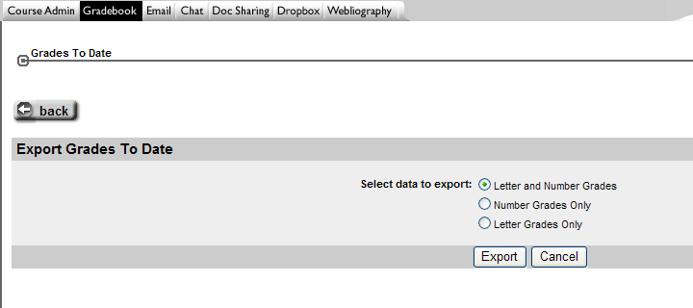
Export Grades
In the screen that opens, choose Letter and Number Grades and click Export.

Slide 15
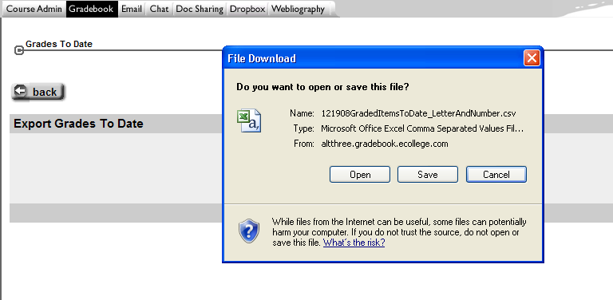
Export Grades
In the dialog box that pops up click Open. Do not save directly from this screen.

Slide 16
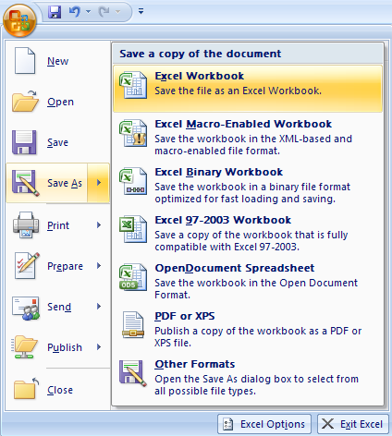
Export Grades
In the spreadsheet that opens do the following:
1. Click the Microsoft Office button.
3. Click Excel Workbook.
2. Click Save As.

Slide 17
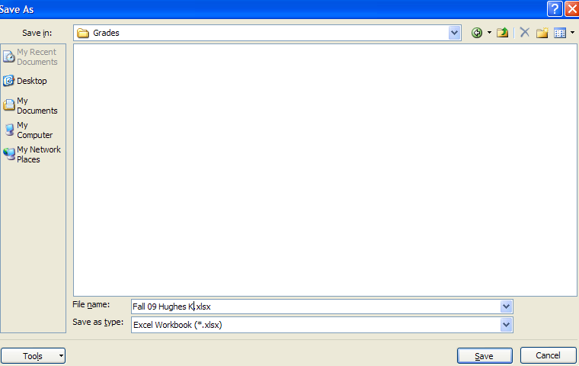
Export Grades
In the dialog box that opens do the following:
1. Navigate to the folder where you want to save your grades.
2. Rename your file 1st Block 14_15 grades like this:
Subject_teacher last name_first name_BLK 1 2014 Example: Science_Cady_Teri_BLK 1 2014
3. Click Save.

Slide 18
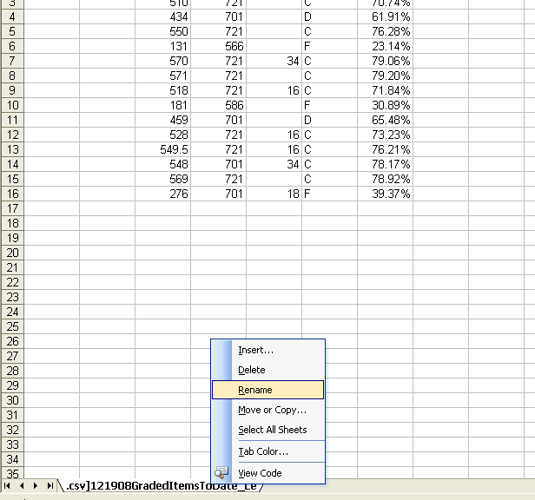
Export Grades
Right-click on the tab and select Rename.
Right-click

Slide 19
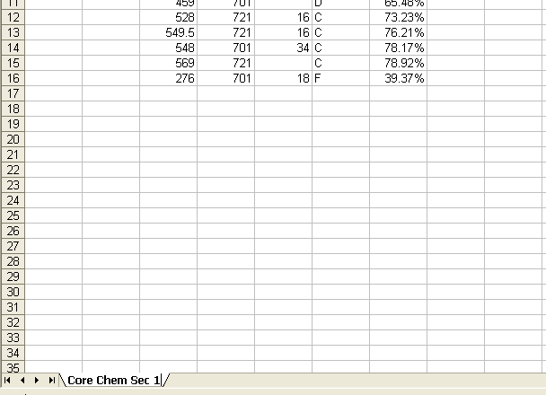
Export Grades
Type over the text, naming the tab to indicate the course and section number.

Slide 20
Compile Grades
Repeat this process for each class (enter letter grades, export to a spreadsheet, delete extra names, fix first name column), but instead of making a new workbook for each subsequent class, please copy and paste each section into a separate tab in one Excel workbook.

Slide 21
Password Protect!
Please password protect your document with utvalynx.
You do not need to delete first names of the students (as we did in past years), but please remember to password protect!

Slide 22
https://utahvirtual.usoe-dcs.org/Login.aspx
New Step: Enter Grade in Aspire
Enter username and password.

Slide 23
New Step: Enter Grade in Aspire
1. Click “classes”
2. Click your name

Slide 24
New Step: Enter Grade in Aspire
3. Click select the course you want to enter grades:
*Note: The “SOEP” courses are the part time students in your course
4. Click “class marks:

Slide 25
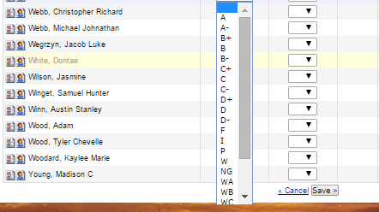
New Step: Enter Grade in Aspire
5. Select the final grade for each student
6. Click “save”
Time Saving Hint: Use the drop down box to move between your block 4 courses easily.

Slide 26
Turn In Grades
Upload your Excel workbook to your invite to the shared dropbox folder “14-15 HS Final Gradebooks”. Make sure to save a copy for yourself too (please keep these saved on your computer).
Grades are due by 5pm Monday, June 8th
Thanks for all of your hard work!

