Slide 1
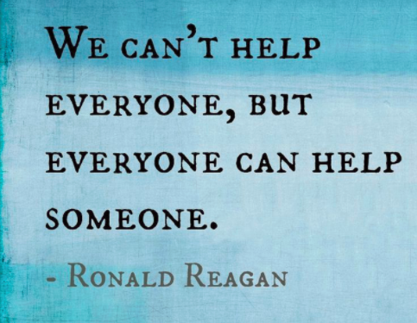
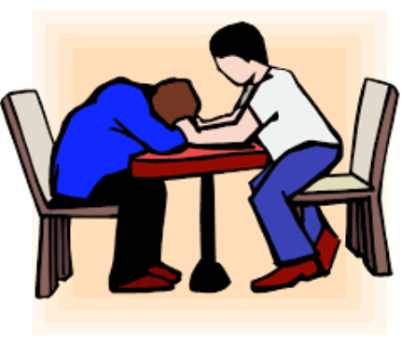
Customer Service @ the SAGE testing site!
By Lacey Robinson

Slide 2
Ideas to keep students HAPPY at testing…
Greet each and every student and LC who enter your testing site. This should NOT just be an assignment from the teacher checking them in. If one or two teachers are in charge of check-in, the rest of you should be walking around greeting, visiting, and getting to know students!
Make sure you are addressing students by their name. If you don’t know or remember it, ASK! Using a person’s name helps them to know they are important to you! NAMETAGS will be your best friend at testing! Get them cheap from the dollar store or on Amazon.
Bring several different flavors of gum for students to chew during testing. Allow them to have a fresh piece after each break if they want.
Stay off your phone, computer, etc. Let students know that today is all about them!
Keep the testing area clean and smelling fresh. Diffuse a small amount of essential oil. Lavender is a popular one for calming, and most people enjoy the smell!
Get students UP and MOVING every 45 minutes or so. Schedule your breaks! Write them on the board so students have something to look forward to! Do something FUN! Be silly, laugh together, play together, get their blood pumping!
Have them repeat affirmations together: “I am calm, I am confident, I can do this!”
Make sure each teacher has an assignment on the big day!

Slide 3
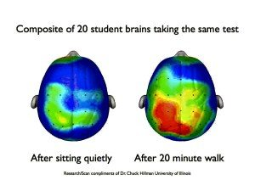
Why do we need fun and interactive breaks during SAGE testing?
Notes:
https://www.teachstarter.com/blog/25-brain-break-ideas-classroom/

Slide 6
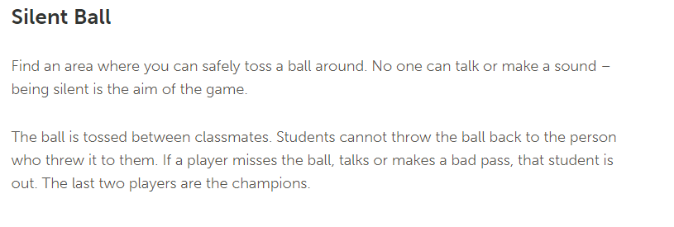

Slide 7
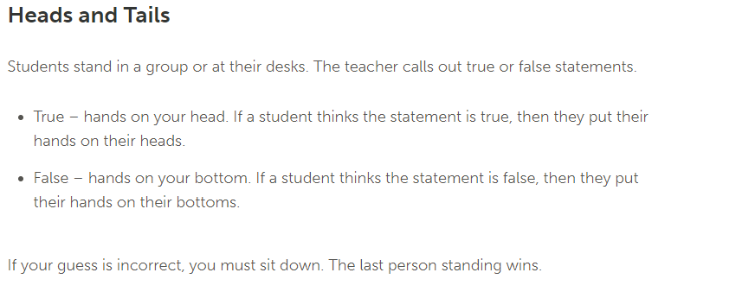

Slide 8
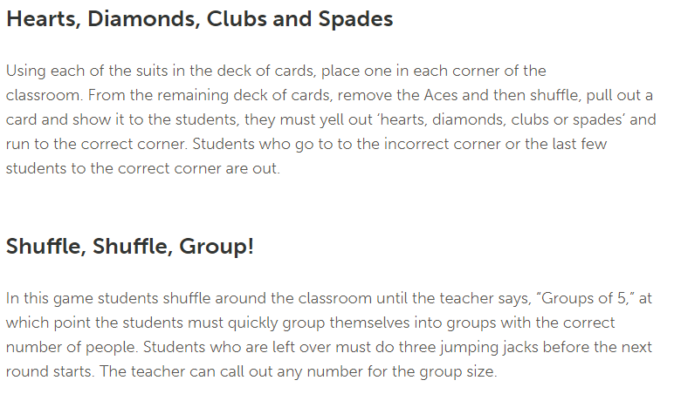

Slide 9
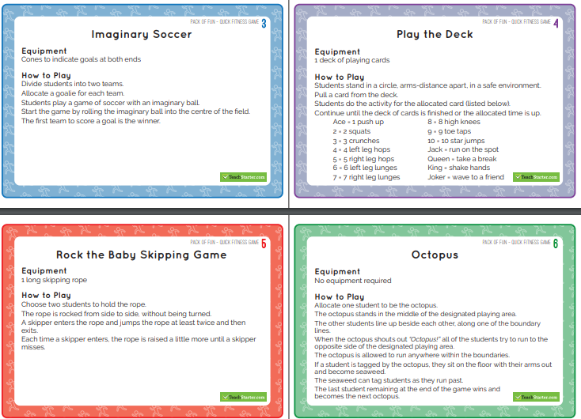
Fitness Cards: Have students randomly select an activity card from the stack:
(Print the attached PDF for this activity)

Slide 10
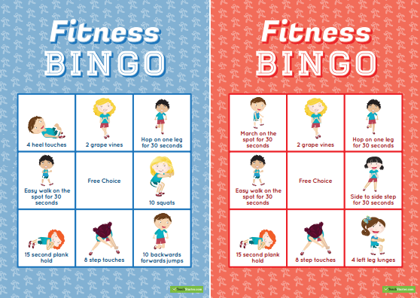
Fitness BINGO
(Print the attached PDF for this activity)

Slide 11
How to handle a student who is ANXIOUS or STRUGGLING…
Take them outside. Fresh air, short walk, drink break. Fresh gum. Snack.
Listen reflectively. Repeat what they are saying back to assure them you understand what they are trying to communicate, and to give their feelings a name: “Ben, it sounds like you are frustrated that the math questions are too difficult. Is that how you are feeling?” Follow up with something like: “Your feelings make sense to me. Let’s see what we can do to get through this!”
Remind them that these tests do not effect their grade, ability to move on to the next grade, or their status at our school at all! This seems to be a huge misunderstanding among students. Assure them that these tests are to help teachers know how to improve for next year’s students. That’s it.
Ask them about something they like to do, their interests, etc. Get them talking about things they love. Find a way to make a connection. Find something you have in common!
Ask if they would like you to share some ideas that other students who are feeling the same way might try. Brainstorm some things they could do together (deep breaths, fresh piece of gum, think of a happy place, etc.)
Bribe them: “If you will work hard for ___ minutes, you can be the first one to choose our next brain break/snack/activity/etc.!”
Stay positive and be patient!
Notes:
Link: https://www.teachstarter.com/blog/25-brain-break-ideas-classroom/

Slide 12
Act as if what you do makes a difference. It does. –William James

