Slide 1
Systems Update
03.17.2015

Slide 2
Production Support: Reports Update
Reports Update:
Omnibus Report
It has been reported that the process of parsing out this report to each school took longer than normal and a few schools may have had blank reports or reports with a timestamp of 3/10/15.
The reporting team is investigating why this process is taking longer and determining the best course of action to fix. More information will be sent out as it becomes available.
Other Reports
All other reports are currently populating for all schools.
As always, if you need a report on a day that pulls blank for you or is unavailable, please have your school’s operations manager open a ServiceNow ticket and we can request one for you.
*Internal Use Only – Do not send this slide to students/LCs

Slide 3
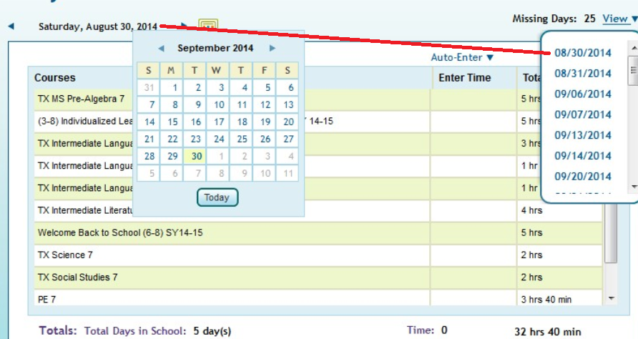
Production Support: Known Issue
OLS is requiring weekend attendance
Some students are now seeing required attendance for the weekends.
Systems fixed this issue on Friday, March 6.
3
*Internal Use Only – Do not send this slide to students/LCs

Slide 4
Production Support: Dino Release
LMS-11328: Identity ID is now displayed in the student’s login in the OLS. This should be the SID. Systems is removing this until it can be implemented correctly and safely to the system. The ID was removed Friday, March 6.
4
*Internal Use Only – Do not send this slide to students/LCs

Slide 5
Production Support: Request Report Button Update
Last week, we reported that the Request Report button would change to say: Request Attendance Report and Recordings.
Through the fix on Friday night, the button itself did not change, but the Request Attendance Report and Recording text appears when a user hovers over the button.
Other details we have learned in the last week:
Users may need to clear their cache and cookies for this new process to work on their computer
Users may need to log out of the OLS completely and log back in for their recordings to become available
Users may need to toggle to the Weekly View in their CC calendar and then back to Daily View for the their recordings to become available.
*Internal Use Only – Do not send this slide to students/LCs

Slide 6
Production Support: Class Connect Session Name Update
Last week, we reported that teachers would be able to use apostrophes in their Class Connect session names again.
This is still true for both newly-created sessions, as well as, for sessions that teachers would like to change their session names back to be grammatically correct; however, a new issue was discovered with apostrophes in Class Connect session names.
The session name never changes in the Class Connect calendar area:
But in the recording link, there is a \ added before the apostrophe:
The systems team is working to determine the root cause of this, but a permanent fix for this issue is still TBD. This is only a cosmetic issue and is NOT affecting anyone trying to access and watch the recordings.
*Internal Use Only – Do not send this slide to students/LCs

Slide 7
Production Support: No Recording or Attendance Available in the OLS
A new issue has come to our attention this week with the CC recordings and attendance being available to teachers in the OLS.
This issue can be identified by these 3 occurrences:
View Attendance button is visible to teacher
CCAR in OLS shows as no attendees, even if there were participants in the session
Error message appears that “This Class Connect Session does not have any recordings.”
*Internal Use Only – Do not send this slide to students/LCs

Slide 8
Production Support: No Recording or Attendance Available in the OLS
The systems team has identified the root cause and it working on a solution as their highest priority.
Unfortunately, this issue currently does not resolve itself overnight through the daily process and can only be corrected by script.
If your teachers are reporting that these 3 factors are happening for them and their recordings are not accessible, please have your school’s operations manager submit a ServiceNow ticket with screen shots as well as the CC session details (Session date, session time and session title).
In this situation, we are able to get the recording link for your teachers to KMail out to their students so they can watch the recording.
*Internal Use Only – Do not send this slide to students/LCs

Slide 9
Request Report Feature (also shared in AS Newsletter)
Example of using the new request report feature in the OLS Class Connect Window:
Teacher schedules session from 10 a.m. to 11:00 a.m.
Teacher is in the session from 9:50 a.m. to 11:09 a.m. (She closed the session properly ensuring all students were removed and she was the last to leave) *Please note the end time has exceeded the scheduled end time.
Teacher requests attendance report at 11:10 a.m. (Call is made to BbC to request report, but the data is not ready. It takes 5 minutes from closing the session for the data to be ready)
Data does not populate in the OLS and resides in BbC database. Presently there is not a return call back to obtain the requested data even if the teacher clicks on request report a second time.
A fix is being put into place to address two areas:
teachers can return to request report a second time if data did not integrate
any data not requested or integrated throughout the data window will populate at the 3:00 a.m. EST integration window.

Slide 10
Production Support: Reminder
Back-to-Back Class Connect Sessions.
As has always been the case, the Best Practice is for teachers to wait 5 minutes between launching Class Connect sessions in order for the sessions to initialize and complete.
Sample Scenario:
8-9 am CC session scheduled
9-10 am CC session scheduled
The teacher holds the 1st CC session, then stops the recording, logs out, and logs back in to the 2nd session, starts the recording again, and finishes the 2nd session.
The possible results:
1st session – no attendance shows after clicking the View Attendance button; no recording is available to show for that session specifically
2nd session – attendance is available for this session only; Show Recording is an option
Blackboard system – shows as one session with TOTAL number of participants from BOTH sessions.
Work around:
Teachers should make sure they allow 5 minutes between Class Connect sessions to ensure the Blackboard sessions initialize and show as separate recordings.
*Internal Use Only – Do not send this slide to students/LCs

